Slide 1
Notes:
Introduction
Who am I
Name
Bio – I am primarily a .Net Developer, but I also dabble in Ruby, JS and Python. I am originally from Southport but came to Yorkshire to study and stayed. Currently I am working for a start-up building the API for our app on the Azure.
You can find me online
What am I talking about & who is this talk for
Azure, WebApps & the Azure Services you can use
Aimed at developers and those wanting to know more about the Azure platform.
Azure is a massive platform and even though I am talking about a small section of it I can only give you an overview in time given. But if you have questions ask me I will do my best to answer them now or email me.

Slide 2


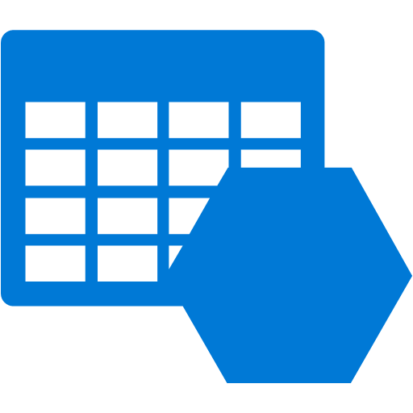



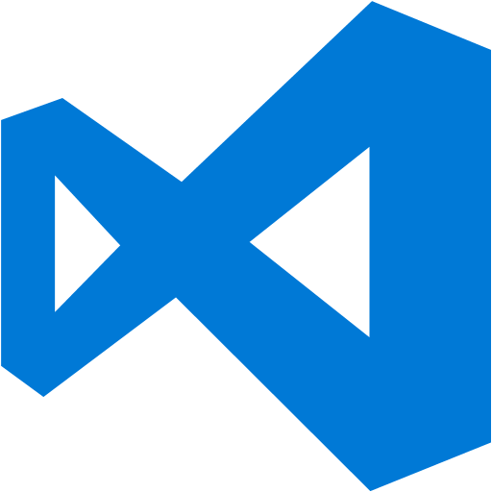
What is Azure
Notes:
On-Prem Vs Cloud Computing
If you have an on-premises data canter you have to deal with the purchasing and installation of the hardware, virtualisation, installing of operating systems plus any software required. Then there is the setup of the network, configuring of firewalls, etc. Then once you have got the servers setup you then need to maintain the servers. All in all a costly process.
With cloud computing the vender is responsible for the servers. They will purchase servers, update and upgrade them for you. The only thing you have to pay for is the use of the servers.
Azure is Microsoft’s entrant to the Cloud computing market.
Microsoft provide a lot of services via the Azure platform, each service will fall into either the Infrastructure-as-a-Service (IaaS) or the Platform-as-a-Service (PaaS) categories.
With IaaS you get access to virtualised hardware, such as virtual servers, load balancers, VPNs, mail servers, Identity servers, etc.
PaaS gives you access to managed services and software. You don’t have to worry about patching servers or upgrading the software this is done for you. All of the services I will talk about today come under the PaaS category.

Slide 3
Azure WebApps
Notes:
What is it
WebApps are a managed cloud service that allows developers to very quickly build, deploy and manage a web sites and web apps into Azure.
The Azure team have tried to make building your app as familiar to you as possible.

Slide 4



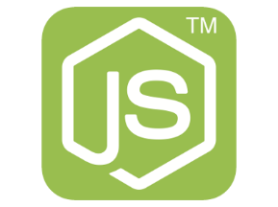
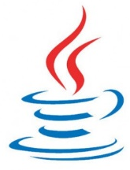

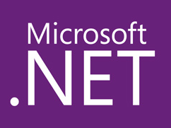

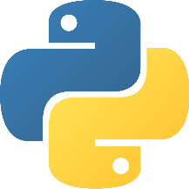

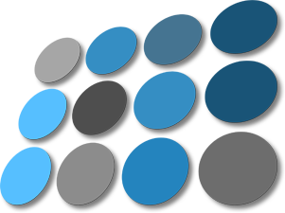

Webapp Tools
Notes:
You can deploy applications written in .Net, NodeJS, PHP, Python and Java.
In addition to creating your own application there are several popular platforms and framework available in the Azure Marketplace you can use as a starting point.
It is very easy to setup, or modify an existing, Continuous Deployment pipeline to Azure. If you are using GitHub, BitBucket or something similar, you can add a web hook so you code is deployed when someone commits. Or like I do use Octopus deploy to deploy after the build and tests have passed on the CI server.
But if you don’t have these tools or you application doesn't need them you can deploy directly from Visual Studio or via an FTP client.
For any console wizards in the room there is a suite of CLI tools and APIs you can use to deploy and configure your app via powershell or bash.

Slide 5
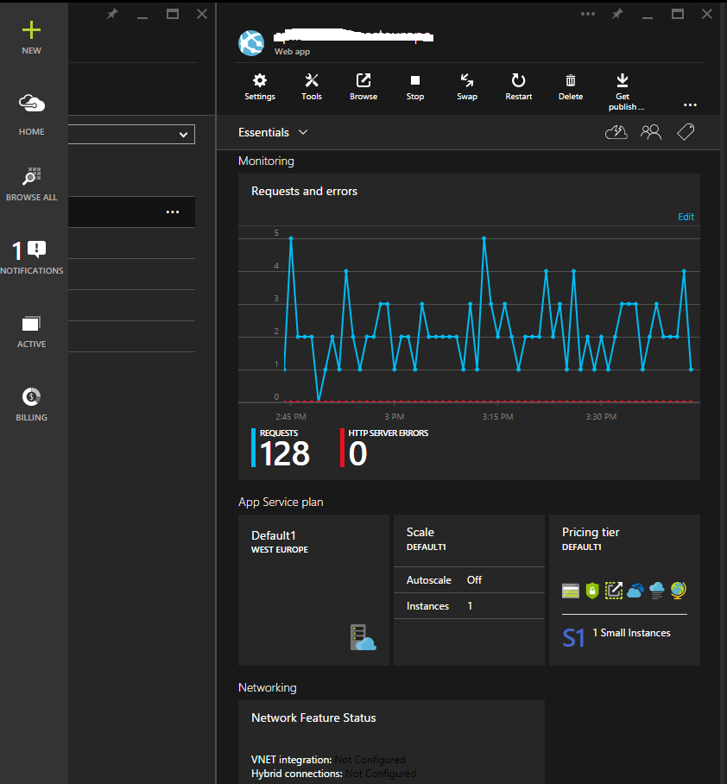
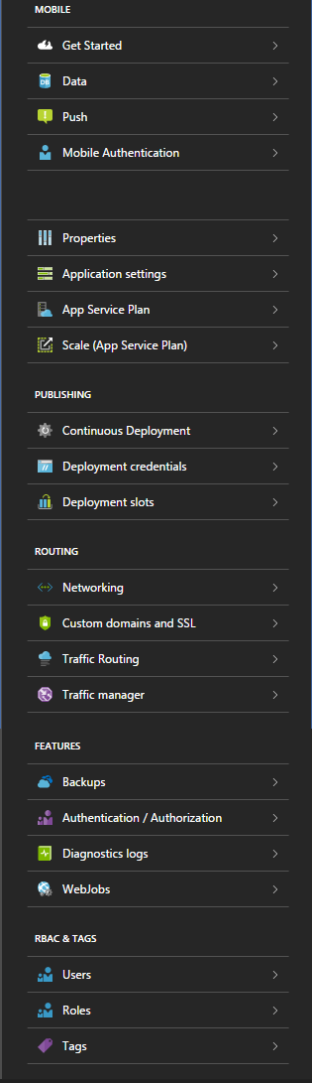
Configuration
Notes:
Once your app has been deployed and you login to the Azure portal, you can access your apps management blade.
This is a typical example of a management blade, this is actually the blade from our dev environment.
At the top there is a graph showing you all the requests coming in and any errors, thankfully there aren’t any.
Clicking the Settings icon will open up the Settings blade. Don’t worry I am not going through all of these.
But a few settings to point out.
Properties – is were you can find, URLs, FTP addresses and credentials, subscriptions IDs, etc.
Application Setting – Here you can select runtime versions of .Net, Java, PHP. You also override any connection strings and app settings you have.
You can change the size of the server instance in App Service Plan.
Scaling we will look at shortly.
Then we have a few options for deploying, this is were you can generate web hooks and set deployment credentials.
The next section is around routing. You can upload SSL certs, configure fail over and load balancing here.
The last two cover background tasks such as backups scheduled jobs and access to the management blade.

Slide 6
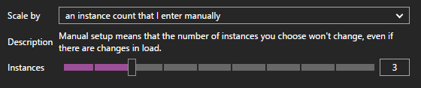
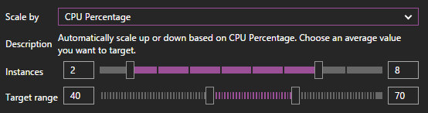
Scaling
ON-DEMAND
CPU USAGE
Notes:
Scaling in the cloud is one of the biggest selling points of cloud computing in my opinion. You can scale you app with on-prem servers, but you need the servers up front and if you get an unexpected spike in traffic your servers may not be able to handle it.
When in the cloud you only pay for what you need, and you can keep scaling out.
If you app becomes hugely successful or you company starts to grow, you will want to consider scaling the web app.
There are 3 options available to you,
On-Demand
CPU Usage
Rule Based Auto-Scale
On-Demand – Simply select how many instances you want. This is good when load increases slowly and predictably.
CPU Usage – The first of the auto scale options. This option tries to keep the average CPU load of the running server instances between the selected boundary. In this example the target CPU uage is somewhere between 40-70% and it will scale from 2 instances up to a max of 8.

Slide 7

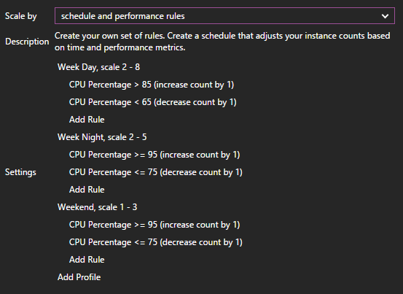
Scaling
AVD. RULES
Notes:
Advanced Rules
This is the second auto scale option available on Azure. And is more configurable than CPU Usage.
For example imagine your app is a high volume stock trading site, during business hours you will receive high load, but out side of those hours there will be relatively no traffic.
Or if you are social media app and some pointless celeb posts something ridicules. There will be an expected spike in traffic.
With the Schedule and Performance Rules you can setup profiles that will monitor specific metrics, over a defined period of time then increase or decrease the number of server instances.
Some of the metrics you can monitor are CPU usage, memory usage, ingress and egress and even message queue length.
In this example there are three profiles,
Week Day, triggers Mon – Fri after 09:00
Week Night, triggers Mon – Fri after 18:00
Weekend, triggers Sat – Sun after 01:00
When the Week Day profile is active, Azure will increment the server instance count by 1, to a max of 8 when the average CPU usage is above 85% for 5 mins. Then remove an instance when the CPU load is less than 65% for 5 mins.
When the Week Night profile is active, Azure will only add up to 5 servers when the CPU load is at 95% for 10mins, and remove a server at 75%.
Over the weekend Azure will go to a max of 3 server when the CPU load is at 95% or more for half an hour and decreasing the server count at 75% for 30 mins.
Any Questions on Web Apps?

Slide 8

Azure Web Roles
Notes:
Web Roles are Web Apps on steroids.
Web Roles part of the Cloud Service feature on Azure and like Web Apps can be used to host a website or web application in IIS.

Slide 9
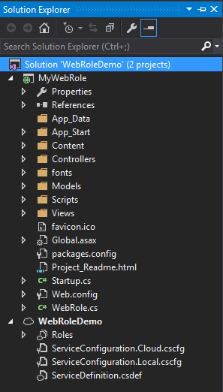
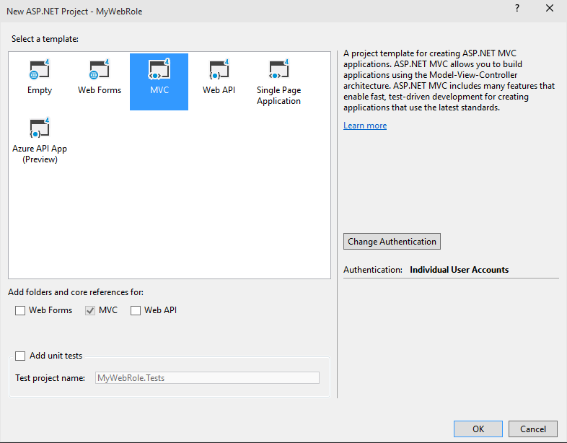
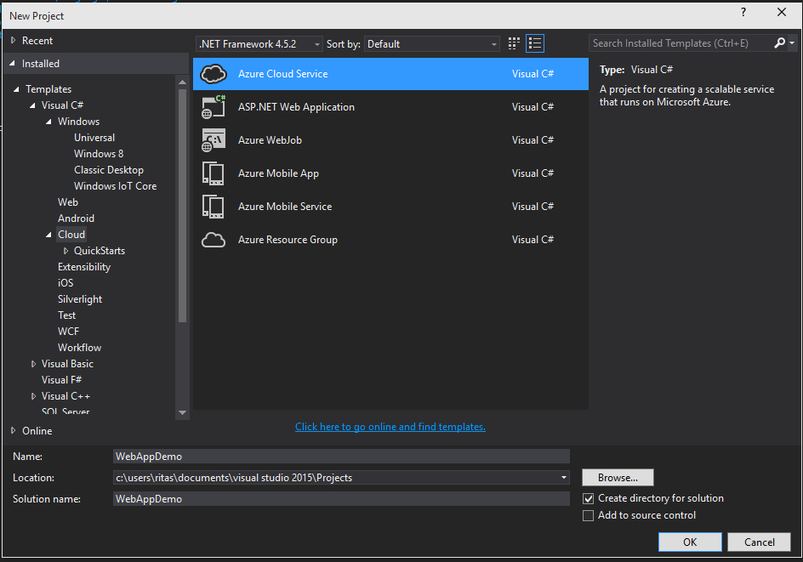
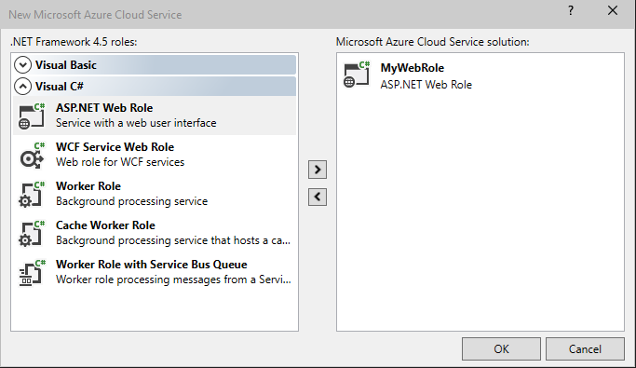
Setting Up a Web Role
Notes:
The setup of a Web Role is different to a conventional .Net MVC application.
In VS Create a new project, and select the Azure Cloud Service project type.
In the Cloud Service window, select the ASP.Net Web Role option and click the little right arrow. You can then edit the name of the service if you wish.
This next window should be familiar. I have just selected a MVC project.
Visual Studio adds 2 project to the solution, the MVC project and the Service Configuration project.
The service Configuration project is the starting point for the web role, this project contains all the app setting for the web role and also the instance configuration. Which I will touch on shortly.
The MVC project is a normal MVC project with one difference. The WebRole.cs class.

Slide 10
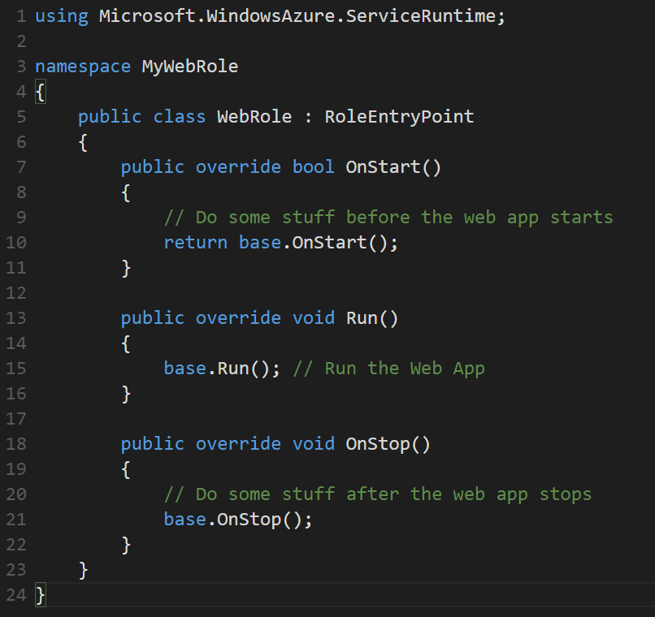
Web Role Entry Point
Notes:
Here is a sample WebRole.cs file.
This is what starts up when the web role starts in Azure. Genrally this is blank, but you can add event handlers, like I have, for when the web role starts and when the web role stops.
For example if your web app used a Redis cache you could prime the cache before the app starts. Or check if queues and tables exist and create them if they don’t.
Lets have a look at the configuration project.

Slide 11
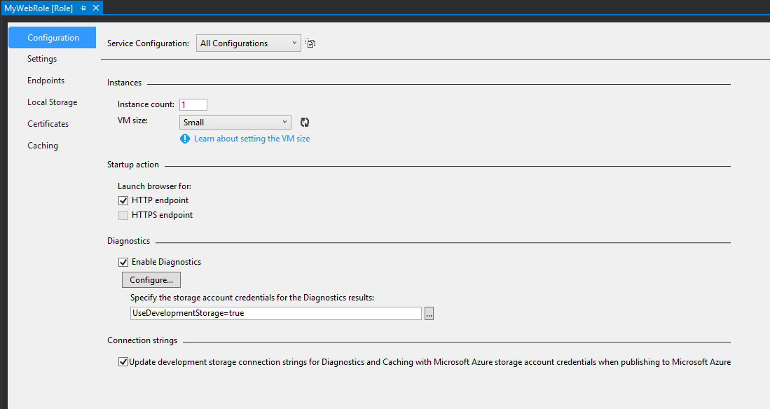
Configuration
Notes:
Double-Clicking the file in the Roles folder will give you access to the Web Roles properties.
Configuration – The instance count and VM size can be set here as well as the Diagnostics settings.
Settings this is like web.config, providing settings that can be used in code. You can also override these settings in the Azure portal while the web role is running.
Endpoints - By default a HTTP endpoint on port 80 will be open. You could change this or add a HTTPS endpoint.
Certificates – Here you can configure the SSL and RDP certificates you have uploaded to the Azure portal.
Local Storage and Cache - You can provide a local file store for each of the instances and a distributed in-memory cache for all role instances, these can be configured here.

Slide 12
Web Apps vs Web Roles
WEB APPS
WEB ROLES
Fast to deploy
Fast provisioning & scaling
Install Marketplace apps
Config transforms on deploy
Remote debugging in VS
Use non standard HTTP ports
Can RDP into the VMs
Run start up scripts with elevated privileges
Full control of IIS
Two deploy slots by default
Deploy multiple web sites
Notes:
Web Apps
Fast to deploy – You can deploy almost instantly it takes seconds compared to the 5+ mins it takes a Web Role.
Fast Provisioning and scaling – Again this takes seconds, you can provision and scale a web app much quicker than a Web Role.
Install Marketplace Apps – Out of the box you have support for installing some of the common open source web applications.
Config transforms on deploy – If you have a web.release.config file then the XDT transformations in this file will automatically be applied before deploying your site.
Remote debugging in VS - You can perform remote debugging from Visual Studio
Web Roles
Use non standard HTTP ports - If you need to create an application that has non standard HTTP ports open you can’t use Web Sites they only allow ports 80 for http and 443 for https.
Can RDP into the VMs – It is possible to setup a remote desktop session for a web role. This gives you the ability to install extra software or configure the server as you want.
Run start up scripts with elevated privileges - You can define a startup task for a web role by adding the Startup element to the service definition file in the configuration project. You could run a script that would add firewall rules or define environment variables before the web roles starts.
Full control of IIS – This is done via a start up task, you could install and configure IIS to use PHP before the web role starts.
Two deploy slots by default – With a web role you get 2 deployment slots, staging and production. Which is really useful if you have a farm of instances. You don’t have to pull nodes out of the farm to upgrade them. You just have to deploy to the staging slot then flip them into the production slot.
Deploy multiple web sites – It is possible to deploy multiple web sites in one web role by defining them in the ServiceDefinition file using the site element.
In conclusion, most of the time a web site will be the best choice. It is the simplest to setup and fastest to deploy. But if you need multiple sites that are massively scalable that require you to run some sort of start up process then maybe Web Roles are for you.
Any questions.

Slide 13
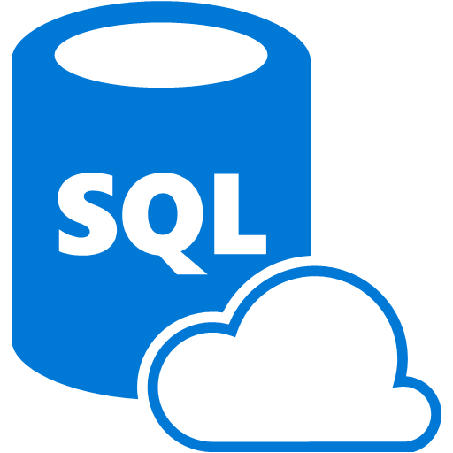
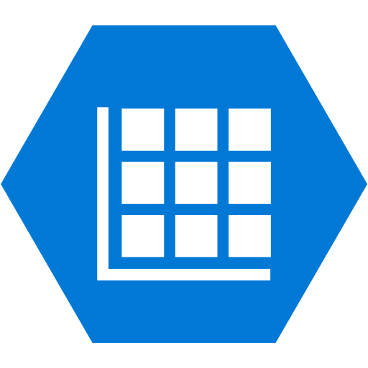

Data Storage
Notes:
Most people are so used to using relational data stores that they tend to forget there are other data store options available when architecting their app.
Some of the common problems I hear are due to relational databases producing suboptimal performance no matter how efficient the query is and being expensive to licence.
A NoSQL data store may have solved their problems, as they can handle tasks better than a relational data store. But it would be stupid to suggest that a NoSQL database can do everything well.

Slide 14
Data Storage
Relational | Key/Value | Column Store | Document | Graph
SQL Server | Dynamo | Cassandra | MongoDB | Allegro
Oracle | Redis | Druid | RavenDB | Neo4j
MySQL | Riak | HBase | CouchDB | OrientDB
SQLite | Aerospike |  | RethinkDB | StarDog
Postgres
Notes:
Most data store technologies will fall into one of these families.
A lot of these data stores are already on Azure either through managed services or marketplace add-ins and many more are becoming available as the community builds containers for them.
There are three managed services on Azure that will cover most of your data storage use cases.
Azure SQL – A cut down version of Microsoft’s popular relational SQL Server.
Table Storage – A fast Key/Value data store
DocumetDB – I will give you one guess which family Document… DB is from.

Slide 15
Azure SQL
Notes:
If you have an on premise server with a vanilla install of the latest version of Windows Server, how long will it take to provision a SQL Server install?
It will probably take about 5mins to setup a brand new SQL instance with an empty database.
What the Azure team are doing here is providing a relational Database-as-a-Service. Because this is a managed service, it takes away all the maintenance and licensing costs.
And all that time spent setting up the SQL server.
Azure SQL provides predictable performance, scalability with no downtime, business continuity and data protection all with almost no administration. Which means you can focus on developing the features of your app using a familiar tool.
Because Azure SQL is built upon the SQL engine it means you can use existing SQL Server tools, libraries and APIs which makes it easier to move your app to the cloud.

Slide 16
Azure SQL
 | Basic | Standard | Premium
DTUs | 5 | 10-100 | 125-1000
Max DB Size | 2GB | 250GB | 500GB
Mx Concurrent Reqs | 30 | 60 - 200 | 200 - 1600
Mx Concurrent Logins | 30 | 60 - 200 | 200- 1600
Mx Sessions | 300 | 600 - 2400 | 2400 -19200
Transaction Rate | 16600/hr | 521 - 5100/min | 105 - 735/sec
Notes:
Azure SQL has three service tiers with different performance aspects.
Basic: Best suited for a small size database, typically used for development or testing, or small scale applications.
Standard: The go-to option for most cloud applications, supporting multiple concurrent queries. Examples include workgroup or web applications.
Premium: Designed for high transactional volume, supporting a large number of concurrent users and requiring the highest level of business continuity capabilities. Examples are databases supporting mission critical applications.
This table gives you some of the limits and governance for the different tiers.
The top DTUs (or Database Transaction Unit) row is a unit of measure that represents the relative power of the database. The metric is a combination of how much CPU, memory and the number of read/writes available to the database. With the resource allocated a basic database with 5 DTUs will be able to complete 5 transaction per second when fully loaded.
Each SQL server instance has 2000 DTUs and you can split that how you want. For example you could have 2 of the Premium databases at 1000 DTUs each or 400 basic databases or anything in between.
Because the databases are allocated a set amount of resource this is how Azure can predicted the performance of the database.

Slide 17
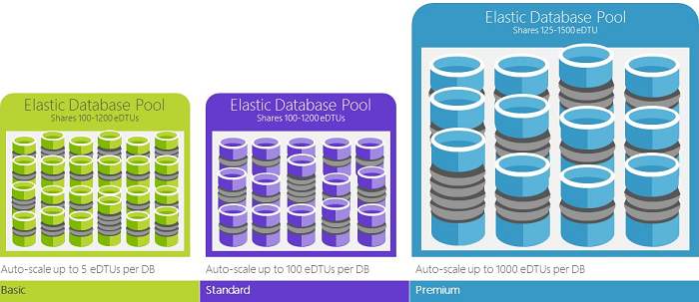
Azure SQL - Scale
Notes:
When developing you app you may choose to start out using a basic database. But in production you will want to change the database tier and as your app goes viral you will want to scale your database.
Elastic scale is a simple concept, you allocate the performance to a pool, and pay for the pool not the databases in use. The pool will auto scale up and down to meet demand, but wont ever exceed the pool allocation , so cost will remain constant.
A simple example would be to have a pool with 1000 DTUs allocated to it and then fill it with 200 basic databases. In code you would connect to the pool and all the sharding would be managed for you.

Slide 18
Azure SQL - Scale
Notes:
When developing you app you may choose to start out using a basic database. But in production you will want to change the database tier and as your app goes viral you will want to scale your database.
Elastic scale is a simple concept, you allocate the performance to a pool, and pay for the pool not the databases in use. The pool will auto scale up and down to meet demand, but wont ever exceed the pool allocation , so cost will remain constant.
A simple example would be to have a pool with 1000 DTUs allocated to it and then fill it with 200 basic databases. In code you would connect to the pool and all the sharding would be managed for you.

Slide 19
DocumentDB
Notes:
Azure DocumentDB is Azures offering in the document database family.
A document databases document is a collection of named fields and values. Where the values can be standard data types or complex objects and arrays. The documents can be encoded in a variety of ways, including BSON, JSON, XML and YAML.
DocumentDB is a fully managed JSON document database as a service and designed to keep pace with modern rapidly evolving applications. DocumentDB executes Javascript within it database engine. Meaning you can write and execute stored procedures and user defined functions directly on the database written in Javascript.
DocumentDB automatically indexes all JSON documents, then allows you to query them with the familiar SQL syntax. A well as JavaScript Azure also provide SDKs in .Net, Java, Python and more, so you up and running quickly with the tools and languages you are already familiar with.

Slide 20
Portal Example
Notes:
Within the Azure portal I provisioned a new DocumentDB instance.
Created a Contacts table and filled it with some demo data.

Slide 21
Azure Table Storage
Notes:
Azure Table Storage is a non-relational, key-value pair data store designed for storing massive amounts of unstructured data and optimised for fast retrieval.
Table storage offers highly available, massively scalable storage so you application can automatically scale to meet demand.
Table storage is scales in terms of data storage rather than server resource. With a single Azure subscription you can create 50 storage accounts and each storage account can store up to 500TB of data, that’s 25 peta bytes of data.
With those sort of volumes of data available you would be pretty miffed if that data was lost.
Azure always at least three copies of you data. When you create a storage account you have to pick one of 4 replication options.
Locally redundant storage – data is replicated 3x in a data centre.
Zone redundant storage – data is replicated 2-3 times within 1 or 2 near by regions.
Geo-redundant storage – data is replicated 6x. 3x in your primary region and 3x in a secondary region which is located hundreds of miles away.
Read-Access Geo-Redundant Storage – The same as Geo-Redundant Storage, but you get read access to the secondary location when the primary location is unavailable.

Slide 22
Table Design
251 Properties
Basic data types – bool, datetime, double, int32, int64, guid, string
Entity size cannot be over 1MB
Design for your queries
Store duplicate entities
Deformalize your data
Use projections
Notes:
Like me, if you are used to developing relational models you will find table storage strange and you will make all the mistakes I have.
There are a number of factors you need to consider when building you data model.
As I said earlier, Table storage is key/value store. Which means every property in an entity has a name and a value. The value can by any of the basic data types plus it can be a byte array as well. You cannot have more than 252 properties to an entity and an entity cannot be more than 1MB in size.
Every entity also has a Partition Key, a Row Key and a Time stamp. The timestamp is updated every time you save the entity. The partition key and row key form a composite key. And how this key is used is why table storage is so fast at retrieving data.
The Partition key groups all entities with the same key into one partition and stores them together on the same server. Key advantages to grouping a set of entities in a single partition is that it is possible to perform batch operations and query a subset of the data.
Data spread across multiple partitions can be load balanced making it possible to have massive data sets that are lighting quick to query.
The Row Key is used to order the data in the partition and to identify a single record. Which means a row key has to be unique within a partition.

Slide 23
Working with 154 million records on Azure Table Storage – the story of “Have I been pwned?”
Troy Hunt
http://www.troyhunt.com/2013/12/working-with-154-million-records-on.html
Notes:
For an example of good table design, Troy Hunt has written a really good blog post about how he setup table storage for his Have I been Pwnd site.
In it he say that he had to put a 400ms delay into his code because table storage was returning too quickly and the UX didn't feel real.

Slide 24


Queues
Notes:
Azure supports two types of queue mechanisms. Azure Queues and Service Bus Queues.
Azure Queues are part of the same Azure Storage service that Table Storage is part of. They provide a simple interface to reliably persist messages between services.
Service Bus queues are part of the wider Azure Messaging service which provides Queues, Topics, Relays and Event Hubs.

Slide 25


Azure Queues
Max message size is 64KB
The number of messages is limited by the storage account data limit, 500TB.
Notes:
Azure Storage Queues was the first queue mechanism on Azure and provides a way of storing a large number of messages for services to process.
A single message can be up to 64KB and the only limit on the number of messages you can store is the storage account data limit of 500TB.
Queues are used to delegate work and decouple your application from long running tasks.
For example you application may allow you users to upload images, But the application needs a thumbnail of the image.
Rather than making your customer wait for the thumbnail to be created you can put the location of the image in a message and put the message on a queue.
Then a background task can take that message off the queue generate the thumbnail, save it and delete the message off the queue.
One thing to be aware of is when a message is read it is not removed off the queue it is hidden for a configurable amount of time. You need to be careful not to set the Invisibility Timeout to low, by default is 2 mins, because your message could appear back on the queue and be read again before you have finished processing it.
I have hit upon this problem when encoding video. Video can take a long time to encode and the timeout on the messages was left at its default of 2mins. Which meant the message was being read multiple times kicking of a new encoding job each time. Until the first job had finished and deleted the message off he queue.

Slide 26
Azure Service Bus
Queues, which allow one-directional communication.
Topics, which provide one-directional communication using a publish/subscribe pattern.
Relays, which provide bi-directional communication.
Event Hubs, which provide event and telemetry ingress to the cloud.
Notes:
The Azure Service Bus Service allows the user to create namespaces where they can setup one or more of the available communication mechanisms.
Queues, which allow one directional communication. A message producer hands off a message to the queue. A single message consumer pulls the message from the queue and processes it.
Topics, which provide one-directional communication using a publish/subscribe pattern. Like queues a single message producer hands a message off to a queue, but multiple message consumers can subscribe to that topic.
Relays, which provide bi-directional communication. Unlike queues and topics a relay doesn’t broker messages via a queue. Instead, it just passes them on to the destination application via WCF messages.
Event Hubs, which provide event and telemetry ingress to the cloud. Event Hubs are use to collect high volumes of data. They can process millions of events per second. For example, Volkswagen could have collect the live emissions data from all its cars using event hubs.

Slide 27

Background Tasks
Notes:
At every size of web application you will probably need to run some sort of background task weather that is clean up data, resize images or process queue messages.
Azure has two services you could use.
Web Jobs, which are part of the Web Apps service. You can run any program or script continuously, on a schedule or on a trigger with a web job.
Worker Roles, which are part of the Cloud Services service. Like a Web Role a Worker Role has an entry point class, which as a number of events that are triggered.

Slide 28
What are WebJobs?
Run scripts and programs in Azure
Supported file types
.cmd, .bat, .exe (using windows cmd)
.ps1 (using powershell)
.sh (using bash)
.php (using php)
.py (using python)
.js (using node)
.jar (using java)
Part of the WebApps service
WebJob SDK makes interfacing with Azure components easy
Can scale with your WebApp
Notes:
Put simply, if you are able to run a script or a program on your local computer you can run it on Azure. All you need to do is upload it.
There are lot of scripts and programs which are supported.
As they are built in to the WebApps service WebJobs get all the feature WebApps do, WebJobs also share the same instance resources as you WebApp.
The WebJobs SDK makes working with over Azure service, such as Blob & table storage, Queues and Service Bus, a breeze.
Because WebJobs are on the same server instance as your WebApp, it means WebApp and WebJob scale together. If your WebApp trigger an autoscale event your WebJob will scale out with the App.

Slide 29
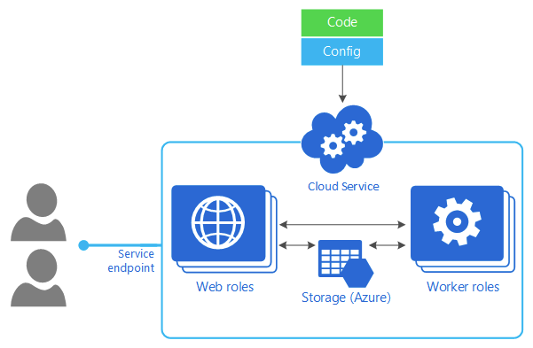
Worker Roles
Notes:
Worker Roles can be thought of the WebJobs powerlifting big brother. Worker Roles are part of the Cloud Services service, which Web Roles are part of too.
So all the features a Web Role has a Worker Role has. The difference between a Web Role and a Worker role is that Worker Roles are not hosted in IIS so cannot contain one or more web applications. A Worker Role can be thought of as Windows services that execute background tasks but in the cloud.
Unlike a WebJob a WorkerRole is hosted in its own VM, so any resource heavy tasks wont affect the Website. This also means it can scale independently of a WebApp or Web Role.

Slide 30
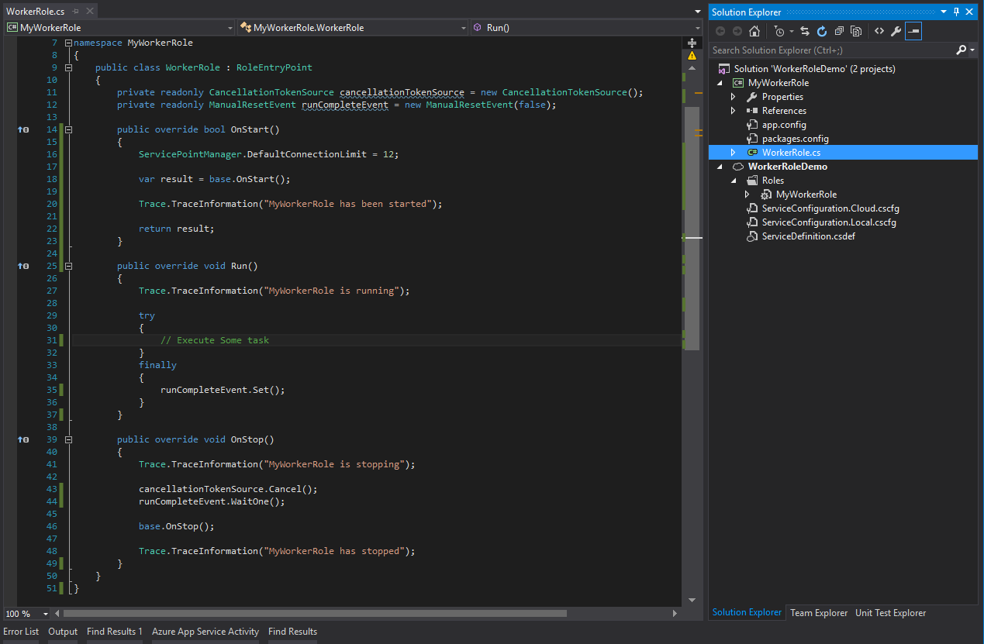
Worker Roles
Notes:
Worker Roles still has a RoleEntryPoint class and the Service Configuration project, but we don’t have the ASP.NET that we had earlier.

Slide 31
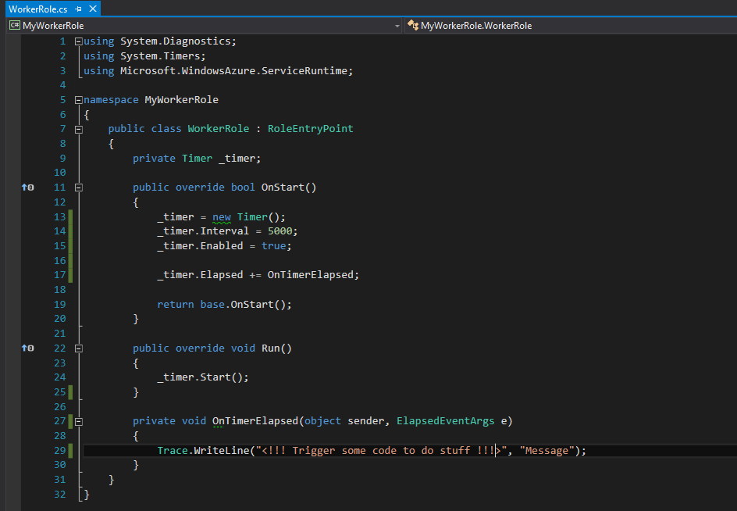
Worker Roles
Notes:
Here I have modified the class to write some text out every 5 seconds using a Timer event. It is not spectacular but it shows how the Worker Role creates and sets up the Timer in the OnStart method. Then Starts the timer in the Run method.
While both WebJobs and Worker Roles are able to process background tasks.
WebJobs can only do one thing, you would have to deploy many different WebJobs to process different tasks.
If you required additional software installed to complete a task, a Worker Role would be the only choice as you can RDP into a Worker Role but you cannot on a WebJob.
If your objective is to run scheduled jobs only using the libraries available in .Net then a WebJob would be the correct choice.
In my opinion I would start off with a WebJob as they are easy to setup and deploy. They also scale really well and are cheap. If you find in the future that WebJobs are suboptimal for whatever you are doing you can move over to a Worker Role.

